Slide 1

CLaSS Bitesize: Effective Presentations
Centre for Learning and Study Support (CLaSS)

Slide 2

What makes an effective presentation?
Consider two aspects:
Planning
Delivery

Slide 3

Planning: It’s all in the small details . . .
When is the presentation?
How long is the presentation?
What is the topic and focus?
What is being assessed?

Slide 4
Plan from the audience’s perspective...
Think about presentations you have seen:
What makes a successful presentation?
What makes an unsuccessful presentation?
Task: Note down three ideas for each question

Slide 5
Plan: From the audience’s perspective...
What makes a successful presentation?
Pitched at the right level
Speaker has eye contact with audience
Clear and engaging visual aids
What makes an unsuccessful presentation?
Too much information
Speaker talks too quickly or too quietly
Content is not relevant for the audience
Notes:
Add further suggestions from group

Slide 6
Planning: Choose your content
Your content will show how well you know and understand your topic
Try “MoSCoW” prioritisation
Must; Should; Could; Won’t
DANGER!
Too much information!
Must | Should | Could | Won’t

Slide 7
Planning: A clear structure
Beginning: Introduce yourself, explaining the purpose of your presentation and what you will cover
Middle: As for an essay, break down into clear sections linked to key topics or ideas. Clear roles for group presentations.
End: Briefly sum up your points; do you need a references slide?; plan for a line to end with, such as “Thank you, any questions?”
Tell them what you’re going to say.
Say it.
Tell them what you’ve said.

Slide 8
Planning: Good Visual Aids
Avoid Long Explanations
Make Presentations Memorable
Keep Audience’s Attention
Benefits
You could use Images, Diagrams, “SmartArt” or…

Slide 9

Delivery: Rehearsal
Try not to avoid reading a script
Use notes or slides as reminders
Rehearse
Timekeeping
Body language
Voice projection
Pace and tone of speech

Slide 10
Delivery: Answering questions
Briefly summarise the question in your own words
Answer the question that has been asked
Check with questioner
Keep answers brief
If you don’t know be honest

Slide 11

Delivery: Overcoming nerves
Prepare carefully and practice
If you know your topic well you are more likely to speak with confidence
Arrive on time, look good and smile
Look at your audience
Breathe out more slowly than usual

Slide 12
Further Resources
Books in DMU Library:
Presentation skills for students https://capitadiscovery.co.uk/dmu/items/896761
A student's guide to presentations: making your presentation count https://capitadiscovery.co.uk/dmu/items/818283
Video clips on doing an effective presentation: http://www.brunel.ac.uk/learnhigher/giving-oral-presentations/evaluating-your-performance.shtml
Focus on: presentations: http://libguides.library.dmu.ac.uk/ld.php?content_id=1879521

Slide 13




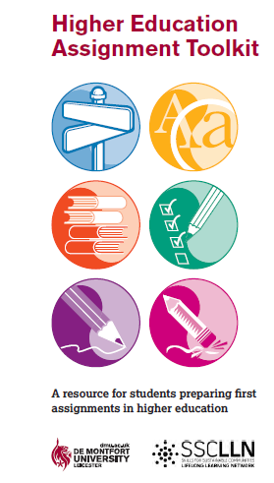
Centre for Learning and Study Support Enhancing academic practice, writing development and professional skills
Tutorials and Drop-in
Workshops
Workshops run every two weeks: Keep an eye out on blackboard and MyDMU to see our upcoming sessions
To sign up go the library what’s on page: www.library.dmu.ac.uk/Home/Calendar
Book a 30 minute one-to-one appointment to discuss any aspect of your study or work: visit the Library “What’s on?” page to book.
Just a quick question? Drop in every Monday, Wednesday and Friday 2-3pm, Tuesday and Thursday 5-6pm in the LDZ Kimberlin library (term time only) where CLaSS will be waiting to answer your question!
Guides
To view our online resources go to: www.library.dmu.ac.uk/link/CLASS
To help fit the pieces of your study together visit: www.library.dmu.ac.uk/link/CLASS

